Slide 1
Airplane passenger satisfaction prediction
Done by:-
Sonali
Thasneema
Faizan
Usman

Slide 2
Problem Statement
If the passenger is satisfied with the airplane service or not.
How to improve in providing better service to the passengers

Slide 3
About Dataset
This dataset has 129880 rows and 24 columns
Gender: Gender of the passengers (Female, Male)
Customer Type: The customer type (Loyal customer, disloyal customer)
Age: The actual age of the passengers
Type of Travel: Purpose of the flight of the passengers (Personal Travel, Business Travel)
Class: Travel class in the plane of the passengers (Business, Eco, Eco Plus)
Flight distance: The flight distance of this journey
Inflight wifi service: Satisfaction level of the inflight wifi service (0:Not Applicable;1-5)
Departure/Arrival time convenient: Satisfaction level of Departure/Arrival time convenient
Ease of Online booking: Satisfaction level of online booking
Gate location: Satisfaction level of Gate location
Food and drink: Satisfaction level of Food and drink
Online boarding: Satisfaction level of online boarding
Seat comfort: Satisfaction level of Seat comfort

Slide 4
Inflight entertainment: Satisfaction level of inflight entertainment
On-board service: Satisfaction level of On-board service
Leg room service: Satisfaction level of Leg room service
Baggage handling: Satisfaction level of baggage handling
Check-in service: Satisfaction level of Check-in service
Inflight service: Satisfaction level of inflight service
Cleanliness: Satisfaction level of Cleanliness
Departure Delay in Minutes: Minutes delayed when departure
Arrival Delay in Minutes: Minutes delayed when Arrival
Satisfaction: Airline satisfaction level(Satisfaction, neutral or dissatisfaction)

Slide 5
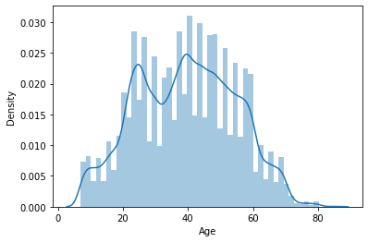
Age distribution in the dataset
Majority of the age is between 30 to 60 years

Slide 6
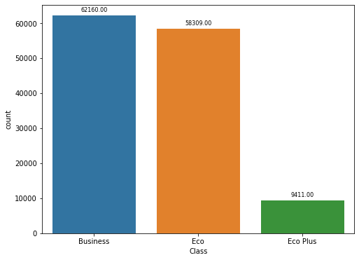
Count of passengers travelling in different classes
Here we can see that majority of passengers from the airlines use business class over other class.
Economy plus class is rarely used by the passengers for travelling.

Slide 7
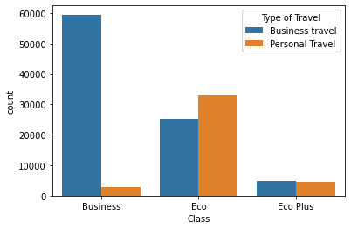
Type of travel of passengers on the basis of class
Most of business travel passengers prefer business class
Personal travel passengers prefer economy class over business class

Slide 8
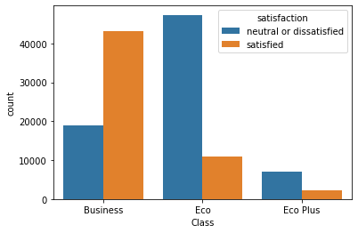
Satisfaction based on class
Here we can see that most of the business class passengers are more satisfied as compared to other classes.
In economy and economy plus class more passengers are dissatisfied

Slide 9
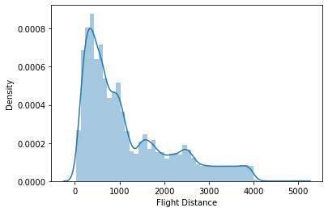
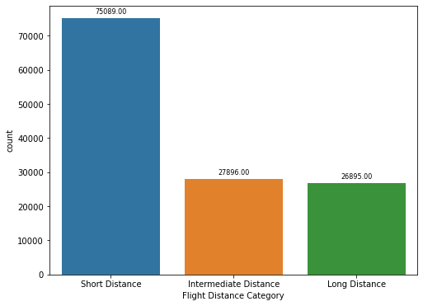
Flight Distance Distribution
From the plots we can see that most people prefer using the airline for short distance i.e. distances less than 1000 compared to long distance.
It is possibly due to the fact that most people are dissatisfied with the service so they prefer using the airline for short distance

Slide 10
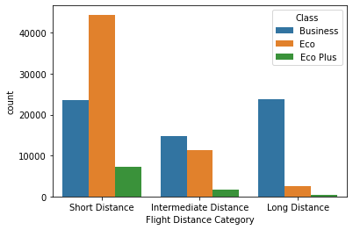
Class on the basis of distance
Passengers prefer to use economy class overall as compared to other classes.
Business class is used more when passengers travel for long distance.
Economy plus class is rarely used by passengers.

Slide 11
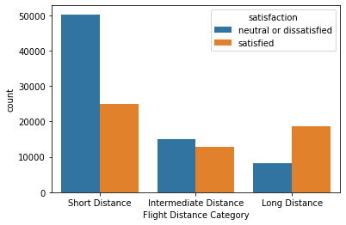
Satisfaction of passengers based on flight distance
From the plot we can see that short distance travellers are more dissatisfied with the service as compared to others because short distance passengers use economy class more
Long distance passengers are satisfied with the service because they use business class more to travel

Slide 12
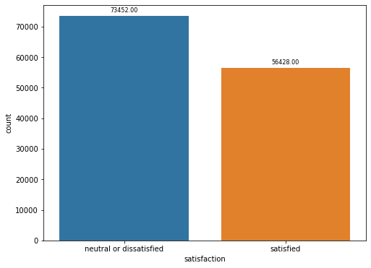
Passenger satisfaction
As per bar graph we can see more passengers are dissatisfied by the service provided by the airlines
73452 passengers are dissatisfied which is 57% of the total data
56428 passengers are satisfied which is 43% of total data

Slide 13
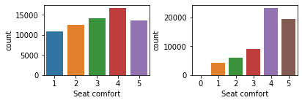
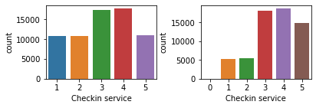
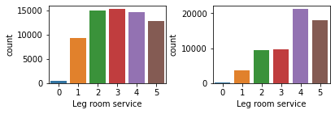
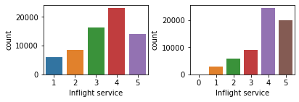
Suggestions
The plots on the left side of the block are of economy and economy plus class and plots on the right side of the block are of business class
From the plots we can see that many passengers have given low ratings in economy class
Therefore, the airline needs to work on improving the quality of service provided in order to increase overall ratings

Slide 14
Conclusion
In various plots we saw that more passengers were dissatisfied with the service as compared to satisfied.
On comparison between classes we saw that economy class passengers are mostly dissatisfied with seat comfort, leg room,checkin service and inflight services for economy class the airline needs to provide better service in economy class, in order to improve overall satisfaction of all passengers
In conclusion we can say that the majority of dissatisfied passengers are of economy class and most of business class passengers are satisfied with the service, so the airline needs to work on providing better service in economy class as well.

